Slide 1
Content-based recommendation

Slide 2



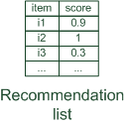

Content-based recommendation
While CF – methods do not require any information about the items,
it might be reasonable to exploit such information; and
recommend fantasy novels to people who liked fantasy novels in the past
What do we need:
some information about the available items such as the genre ("content")
some sort of user profile describing what the user likes (the preferences)
The task:
learn user preferences
locate/recommend items that are "similar" to the user preferences
"show me more of the same what I've liked"

Slide 3

What is the "content"?
Most CB-recommendation techniques were applied to recommending text documents.
Like web pages or newsgroup messages for example.
Content of items can also be represented as text documents.
With textual descriptions of their basic characteristics.
Structured: Each item is described by the same set of attributes
Unstructured: free-text description.
Title | Genre | Author | Type | Price | Keywords
The Night of the Gun | Memoir | David Carr | Paperback | 29.90 | Press and journalism, drug addiction, personal memoirs, New York
The Lace Reader | Fiction, Mystery | Brunonia Barry | Hardcover | 49.90 | American contemporary fiction, detective, historical
Into the Fire | Romance, Suspense | Suzanne Brockmann | Hardcover | 45.90 | American fiction, murder, neo-Nazism

Slide 4
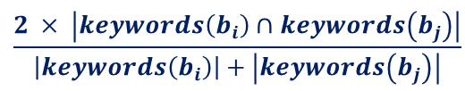
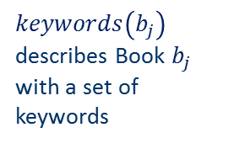
Content representation and item similarities
Item representation
Title | Genre | Author | Type | Price | Keywords
The Night of the Gun | Memoir | David Carr | Paperback | 29.90 | Press and journalism, drug addiction, personal memoirs, New York
The Lace Reader | Fiction, Mystery | Brunonia Barry | Hardcover | 49.90 | American contemporary fiction, detective, historical
Into the Fire | Romance, Suspense | Suzanne Brockmann | Hardcover | 45.90 | American fiction, murder, neo-Nazism
User profile
$keywords\left(b_{j}\right)$ describes Book $b_{j}$ with a set of keywords
Title | Genre | Author | Type | Price | Keywords
… | Fiction | Brunonia, Barry, Ken Follett | Paperback | 25.65 | Detective, murder, New York
Simple approach
Compute the similarity of an unseen item with the user profile based on the keyword overlap (e.g. using the Dice coefficient)
Or use and combine multiple metrics
$$\frac{2 × \left|keywords\left(\left.b_{i}\right)\right.∩keywords\left(b_{j}\right)\right|}{\left|keywords\left(\left.b_{i}\right)\right.\right|+\left|keywords\left(\left.b_{j}\right)\right.\right|}$$

Slide 5

Term-Frequency - Inverse Document Frequency ($TF−IDF$)
Simple keyword representation has its problems
in particular when automatically extracted as
not every word has similar importance
longer documents have a higher chance to have an overlap with the user profile
Standard measure: TF-IDF
Encodes text documents in multi-dimensional Euclidian space
weighted term vector
TF: Measures, how often a term appears (density in a document)
assuming that important terms appear more often
normalization has to be done in order to take document length into account
IDF: Aims to reduce the weight of terms that appear in all documents

Slide 6
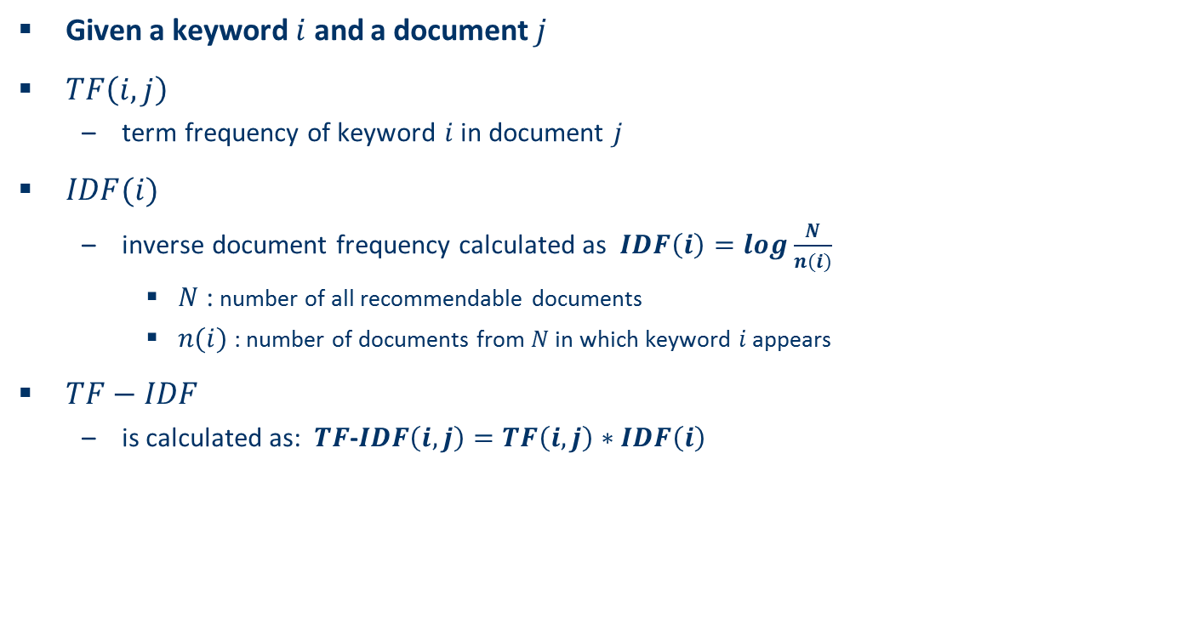
TF-IDF II
Given a keyword $i$ and a document $j$
$TF\left(i,j\right)$
term frequency of keyword $i$ in document $j$
$IDF(i)$
inverse document frequency calculated as $IDF\left(i\right)=log\frac{N}{n(i)}$
$N$ : number of all recommendable documents
$n(i)$: number of documents from $N$ in which keyword $i$ appears
$TF−IDF$
is calculated as: $TF$-$IDF\left(i,j\right)=TF\left(i,j\right)∗IDF\left(i\right)$

Slide 7
Example TF-IDF representation
Term frequency:
Each document is a count vector in $ℕ^{\left|v\right|}$
 | Antony and Cleopatra | Julius Caesar | The Tempest | Hamlet | Othello | Macbeth
Antony | 157 | 73 | 0 | 0 | 0 | 0
Brutus | 4 | 157 | 0 | 1 | 0 | 0
Caesar | 232 | 227 | 0 | 2 | 1 | 1
Calpurnia | 0 | 10 | 0 | 0 | 0 | 0
Cleopatra | 57 | 0 | 0 | 0 | 0 | 0
mercy | 1.51 | 0 | 3 | 5 | 5 | 1
worser | 1.37 | 0 | 1 | 1 | 1 | 0
Vector $v$with dimension $\left|v\right|=7$
Example taken from http://informationretrieval.org

Slide 8

Example TF-IDF representation
Combined TF-IDF weights
Each document is now represented by a real-valued vector of $TF$-$IDF$weights $∈ℝ^{\left|v\right|}$
 | Antony and Cleopatra | Julius Caesar | The Tempest | Hamlet | Othello | Macbeth
Antony | 157 | 73 | 0 | 0 | 0 | 0
Brutus | 4 | 157 | 0 | 1 | 0 | 0
Caesar | 232 | 227 | 0 | 2 | 1 | 1
Calpurnia | 0 | 10 | 0 | 0 | 0 | 0
Cleopatra | 57 | 0 | 0 | 0 | 0 | 0
mercy | 1.51 | 0 | 3 | 5 | 5 | 1
worser | 1.37 | 0 | 1 | 1 | 1 | 0
 | Antony and Cleopatra | Julius Caesar | The Tempest | Hamlet | Othello | Macbeth
Antony | 5.25 | 3.18 | 0 | 0 | 0 | 0.35
Brutus | 1.21 | 6.1 | 0 | 1 | 0 | 0
Caesar | 8.59 | 2.54 | 0 | 1.51 | 0.25 | 0
Calpurnia | 0 | 1.54 | 0 | 0 | 0 | 0
Cleopatra | 2.85 | 0 | 0 | 0 | 0 | 0
mercy | 1.51 | 0 | 1.9 | 0.12 | 5.25 | 0.88
worser | 1.37 | 0 | 0.11 | 4.15 | 0.25 | 1.95
Example taken from http://informationretrieval.org

Slide 9
Improving the vector space model
Vectors are usually long and sparse
remove stop words
They will appear in nearly all documents.
e.g. "a", "the", "on", …
use stemming
Aims to replace variants of words by their common stem
e.g. "went" "go", "stemming" "stem", …
size cut-offs
only use top n most representative words to remove "noise" from data
e.g. use top 100 words

Slide 10
Improving the vector space model II
Use lexical knowledge, use more elaborate methods for feature selection
Remove words that are not relevant in the domain
Detection of phrases as terms
More descriptive for a text than single words
e.g. "United Nations"
Limitations
semantic meaning remains unknown
example: usage of a word in a negative context
"there is nothing on the menu that a vegetarian would like.."
The word "vegetarian" will receive a higher weight then desired
an unintended match with a user interested in vegetarian restaurants

Slide 11
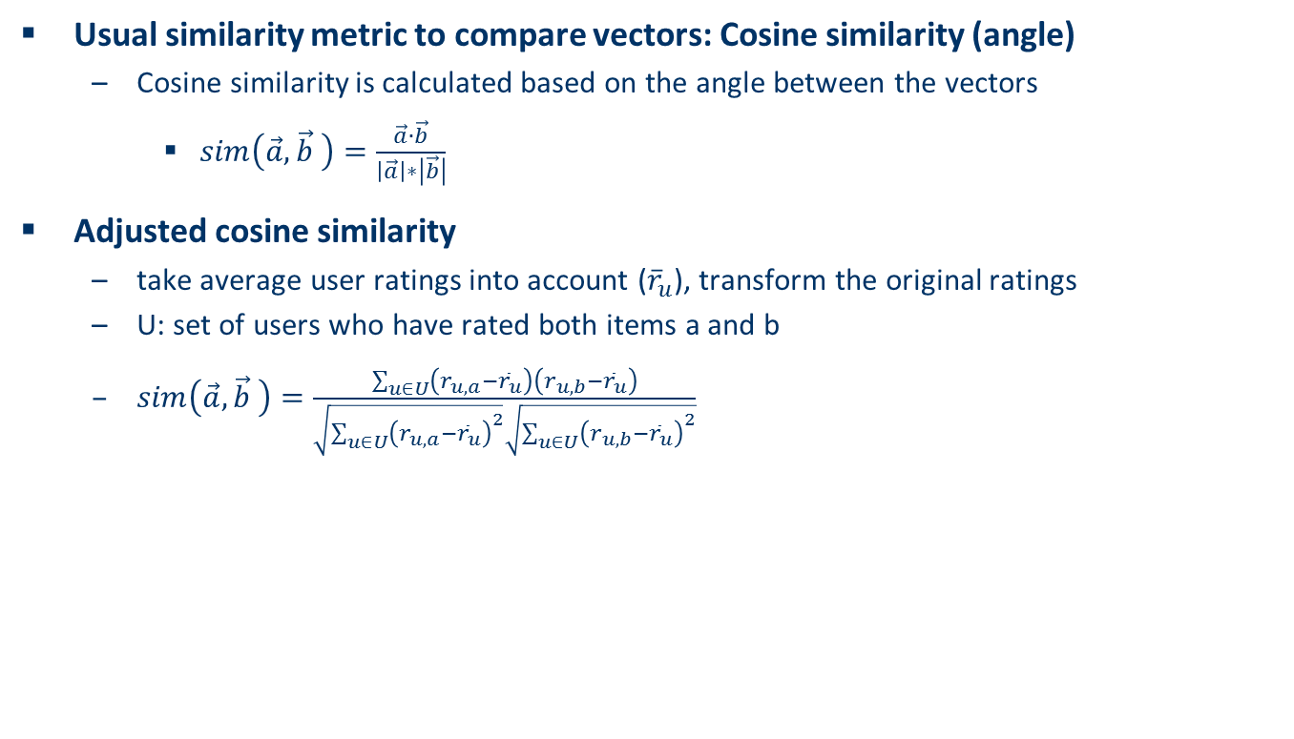
Cosine similarity
Usual similarity metric to compare vectors: Cosine similarity (angle)
Cosine similarity is calculated based on the angle between the vectors
$sim\left(\vec{a},\vec{b} \right)=\frac{\vec{a}∙\vec{b}}{\left|\vec{a}\right|∗\left|\vec{b}\right|}$
Adjusted cosine similarity
take average user ratings into account (${\overline{r}}_{u}$), transform the original ratings
U: set of users who have rated both items a and b
$sim\left(\vec{a},\vec{b} \right)=\frac{\sum_{u∈U}{\left(r_{u,a}−{\overline{r}}_{u}\right)}\left(r_{u,b}−{\overline{r}}_{u}\right)}{\sqrt{\sum_{u∈U}{{\left(r_{u,a}−{\overline{r}}_{u}\right)}^{2}}}\sqrt{\sum_{u∈U}{{\left(r_{u,b}−{\overline{r}}_{u}\right)}^{2}}}}$

Slide 12
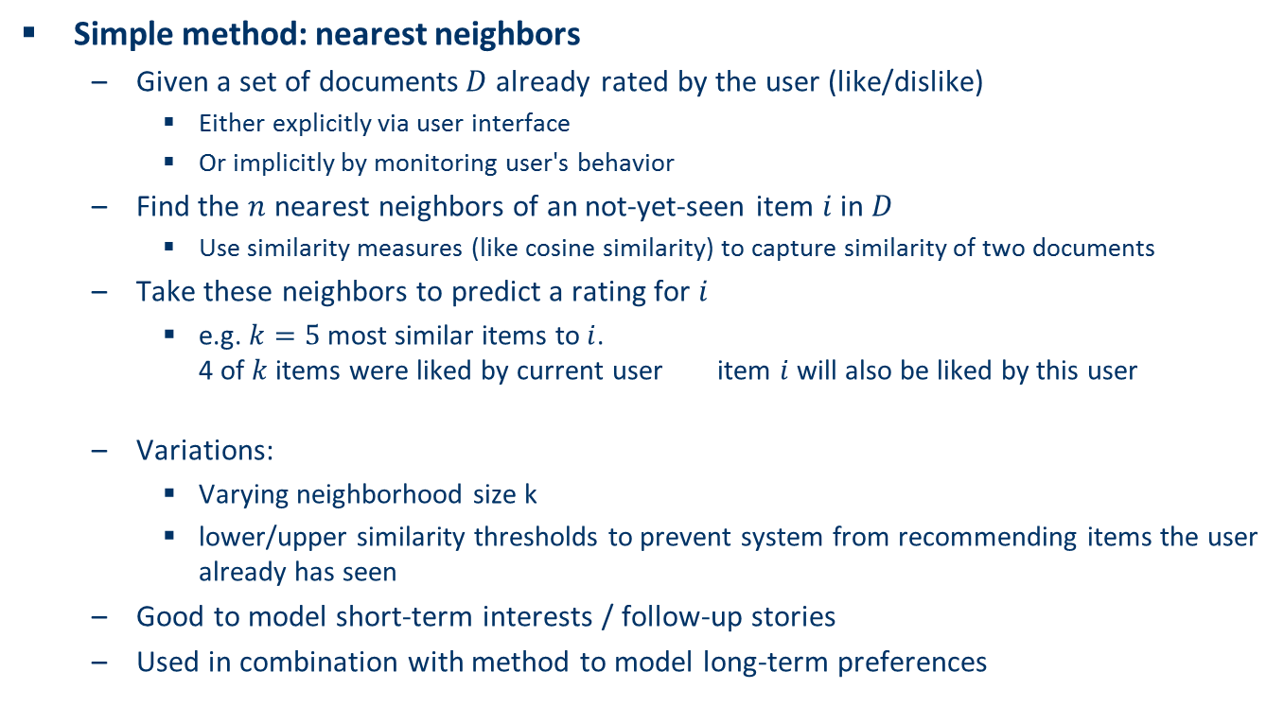
Recommending items
Simple method: nearest neighbors
Given a set of documents$D$already rated by the user (like/dislike)
Either explicitly via user interface
Or implicitly by monitoring user's behavior
Find the $n$ nearest neighbors of an not-yet-seen item $i$ in $D$
Use similarity measures (like cosine similarity) to capture similarity of two documents
Take these neighbors to predict a rating for $i$
e.g. $k=5$ most similar items to$i$. 4 of $k$ items were liked by current user item $i$ will also be liked by this user
Variations:
Varying neighborhood size k
lower/upper similarity thresholds to prevent system from recommending items the user already has seen
Good to model short-term interests / follow-up stories
Used in combination with method to model long-term preferences

Slide 13
Recommending items
Retrieval quality depends on individual capability to formulate queries with right keywords.
Query-based retrieval: Rocchio's method
The SMART System: Users are allowed to rate (relevant/irrelevant) retrieved documents (feedback)
The system then learns a prototype of relevant/irrelevant documents
Queries are then automatically extended with additional terms/weight of relevant documents

Slide 14
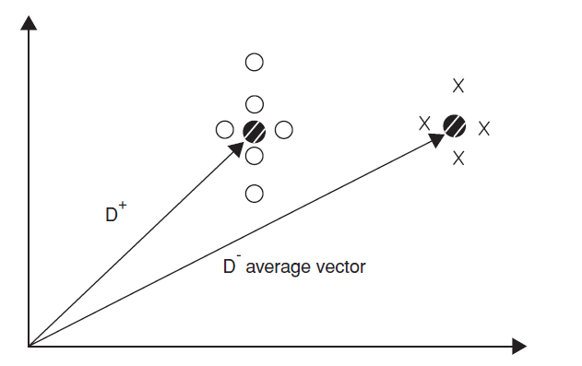
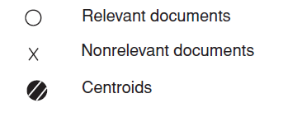
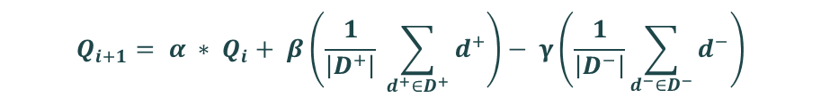
Rocchio details
Document collections D⁺ (liked) and D⁻ (disliked)
Calculate prototype vector for these categories.
Computing modified query Qi+1 from current query Qi with:
α, β, γ used to fine-tune the feedback
α weight for original query
β weight for positive feedback
γ weight for negative feedback
$$Q_{i+1}= α ∗ Q_{i}+ β\left(\frac{1}{\left|D^{+}\right|} \sum_{d^{+}∈D^{+}}{d^{+}}\right)− γ\left(\frac{1}{\left|D^{−}\right|}\sum_{d^{−}∈D^{−}}{d^{−}}\right)$$
Often only positive feedback is used
More valuable than negative feedback

Slide 15
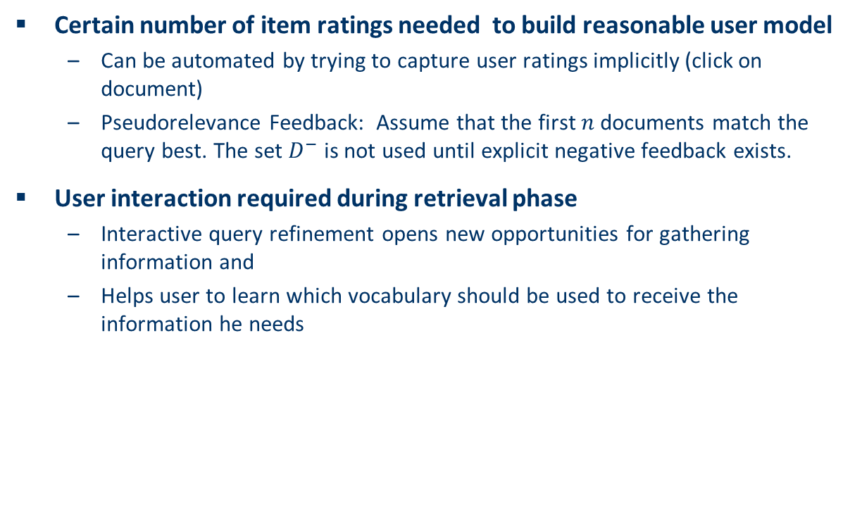
Practical challenges of Rocchio's method
Certain number of item ratings needed to build reasonable user model
Can be automated by trying to capture user ratings implicitly (click on document)
Pseudorelevance Feedback: Assume that the first$n$documents match the query best. The set $D^{−}$ is not used until explicit negative feedback exists.
User interaction required during retrieval phase
Interactive query refinement opens new opportunities for gathering information and
Helps user to learn which vocabulary should be used to receive the information he needs

Slide 16
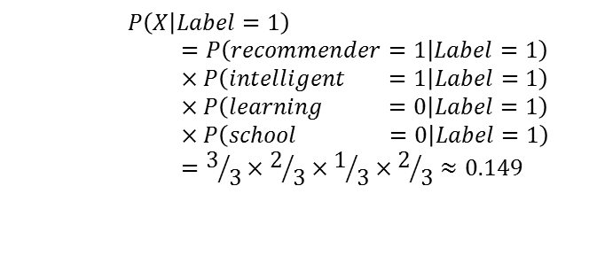
Probabilistic methods
Recommendation as classical text classification problem
long history of using probabilistic methods
Simple approach:
2 classes: hot/cold
simple Boolean document representation
calculate probability that document is hot/cold based on Bayes theorem
Doc-ID | recommender | intelligent | learning | school | Label
1 | 1 | 1 | 1 | 0 | 1
2 | 0 | 0 | 1 | 1 | 0
3 | 1 | 1 | 0 | 0 | 1
4 | 1 | 0 | 1 | 1 | 1
5 | 0 | 0 | 0 | 1 | 0
6 | 1 | 1 | 0 | 0 | ?
$$P\left(X | Label=1\right)=P\left(recommender=1 | Label=1\right)×P\left(intelligent =1 | Label=1\right)×P\left(learning =0 | Label=1\right)×P\left(school =0 | Label=1\right)=3/3×2/3×1/3×2/3≈0.149$$

Slide 17
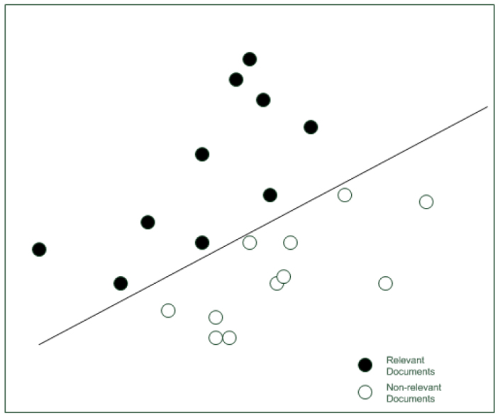
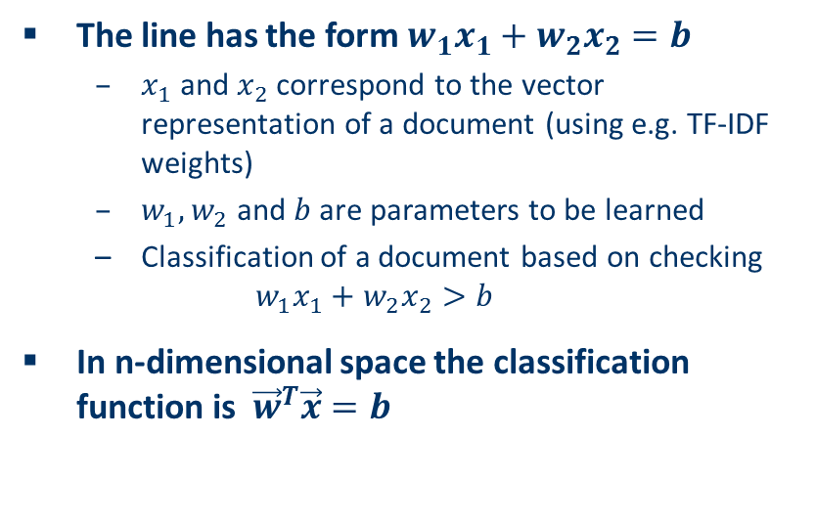
Linear classifiers
Most learning methods aim to find coefficients of a linear model
A simplified classifier with only two dimensions can be represented by a line
The line has the form $w_{1}x_{1}+w_{2}x_{2}=b$
$x_{1}$ and $x_{2}$correspond to the vector representation of a document (using e.g. TF-IDF weights)
$w_{1},w_{2}$ and $b$ are parameters to be learned
Classification of a document based on checking $w_{1}x_{1}+w_{2}x_{2}>b$
In n-dimensional space the classification function is ${\vec{w}}^{T}\vec{x}=b$
Relevant
Nonrelevant
Other linear classifiers:
Naive Bayes classifier, Rocchio method, Windrow-Hoff algorithm, Support vector machines

Slide 18
Improvements
Side note: Conditional independence of events does in fact not hold
"New York", "Hong Kong"
Still, good accuracy can be achieved
Boolean representation simplistic
positional independence assumed
keyword counts lost
More elaborate probabilistic methods
e.g., estimate probability of term v occurring in a document of class C by relative frequency of v in all documents of the class
Other linear classification algorithms (machine learning) can be used
Support Vector Machines, ..
Use other information retrieval methods (used by search engines..)

Slide 19
Explicit decision models
Decision tree for recommendation problems
inner nodes labeled with item features (keywords)
used to partition the test examples
existence or non existence of a keyword
in basic setting only two classes appear at leaf nodes
interesting or not interesting
decision tree can automatically be constructed from training data
works best with small number of features
use meta features like author name, genre, ... instead of TF-IDF representation.

Slide 20
Explicit decision models II
Rule induction
built on RIPPER algorithm
good performance compared with other classification methods
eloborate postpruning techniques of RIPPER
extension for e-mail classification
takes document structure into account
main advantages of these decision models:
inferred decision rules serve as basis for generating explanations for recommendation
existing domain knowledge can be incorporated in models

Slide 21
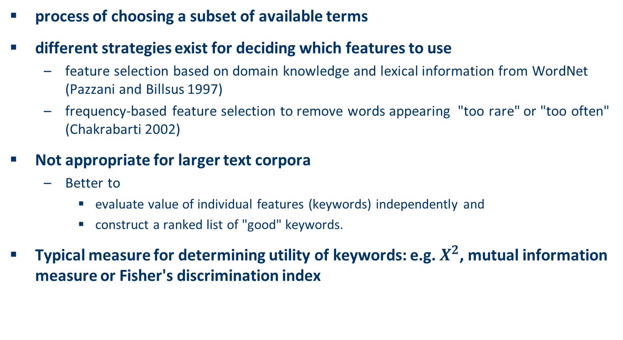
On feature selection
process of choosing a subset of available terms
different strategies exist for deciding which features to use
feature selection based on domain knowledge and lexical information from WordNet (Pazzani and Billsus 1997)
frequency-based feature selection to remove words appearing "too rare" or "too often" (Chakrabarti 2002)
Not appropriate for larger text corpora
Better to
evaluate value of individual features (keywords) independently and
construct a ranked list of "good" keywords.
Typical measure for determining utility of keywords: e.g. $X^{2}$, mutual information measure or Fisher's discrimination index

Slide 22
Limitations of content-based recommendation methods
Keywords alone may not be sufficient to judge quality/relevance of a document or web page
up-to-date-ness, usability, aesthetics, writing style
content may also be limited / too short
content may not be automatically extractable (multimedia)
Ramp-up phase required
Some training data is still required
Web 2.0: Use other sources to learn the user preferences
Overspecialization
Algorithms tend to propose "more of the same"
Or: too similar news items

Slide 23
Discussion & summary
In contrast to collaborative approaches, content-based techniques do not require user community in order to work
Presented approaches aim to learn a model of user's interest preferences based on explicit or implicit feedback
Deriving implicit feedback from user behavior can be problematic
Evaluations show that a good recommendation accuracy can be achieved with help of machine learning techniques
These techniques do not require a user community
Danger exists that recommendation lists contain too many similar items
All learning techniques require a certain amount of training data
Some learning methods tend to overfit the training data
Pure content-based systems are rarely found in commercial environments

Slide 24
Literature
[Michael Pazzani and Daniel Billsus 1997] Learning and revising user profiles: The identification of interesting web sites, Machine Learning 27 (1997), no. 3, 313-331.
[Soumen Chakrabarti 2002] Mining the web: Discovering knowledge from hyper-text data, Science & Technology Books, 2002.

